Slide 1
July 2019 Federal Update

Slide 2
Deborah Koolbeck Senior Director, Government Relations, AACTE

Slide 3
Questions will be taken at the end of the presentation.

Slide 4
Appropriations FY2020

Slide 5
Appropriations: U.S. House of Representatives

Slide 6
Labor – H in the House
The Labor, Health and Human Services, Education and Related Agencies bill moved through full committee first!
View the:
Subcommittee Markup
Full Committee Markup
Read the:
Summary before Full Committee Markup
Bill before Full Committee Markup
Report

Slide 7
Key Program Results with + $11.8b for the Allocation
Title II of ESSA $2.556b +500m 24.3%
Title IV of ESSA $1.320b +150m 12.8%
SEED grants $100m +25m 33.3%
Special Education Personnel Prep
$87m +9.8m 12.7%
Pell Grant Max $6345 +150 2.4%
Teacher Quality Partnership Grants
$53m +10m 23.12%
IES Regional Labs $60m +5m 9.0%
IES Rsch SpEd $61m +5m 8.9%
IES Statewide Data $35m +2m 9.3%

Slide 8
Status
Appropriations Minibus #1
H.R. 2740 - Labor, Health and Human Services, Education, Legislative Branch, Defense, State, Foreign Operations, and Energy and Water Development Appropriations Act, 2020
79 amendments offered for the Labor-H bill
Passed on June 19, 2019 by a vote of 226-203
Roll Call Vote 367

Slide 9
Labor-H, the Floor Action Results for the Department of Education
$5 million in adds to ED:
$0.5 million to American Civics national activities
$0.5 million for the National Center for College Students with Disabilities
4 million for the Office of Inspector General
$6 million in cuts to ED departmental management:
$0.5 million Amendment #45 by Rep. Cicilline
$0.5 million Amendment #50 by Rep. Adams
$5 million Amendment #61 by Rep. Lee (NV)
Net change to ED: -$1 million

Slide 10
Raising the Caps for FY20 & FY21
Recall that each year since the 2011 Budget Control Act (BCA), Congress has raised the caps (to amount to be spent) set in the BCA for both non-defense and defense discretionary funds.
The caps were last raised for FY18 & FY19.
If the caps are not raised for FY20, then we are looking at a $54b cut to non-defense discretionary dollars and $71b for defense.
The Congress is in motion on raising the caps now.

Slide 11
Bipartisan Budget Agreement for FY20 & FY21
Allows Senate to move on its appropriations process (was on hold until a budget deal was passed)
Also suspends the debt ceiling until July 2021 (well past the 2020 election)
Increase of $24.1b for non-defense discretionary funds over FY19 (also a $2.5b increase for the Census)
Still $7b below what the House has passed in their appropriations bills
Means that we can still expect to see a cut for Labor-H from the House levels if the increase is allocated the way the House did (cut of $2.3b for Labor-H)

Slide 12
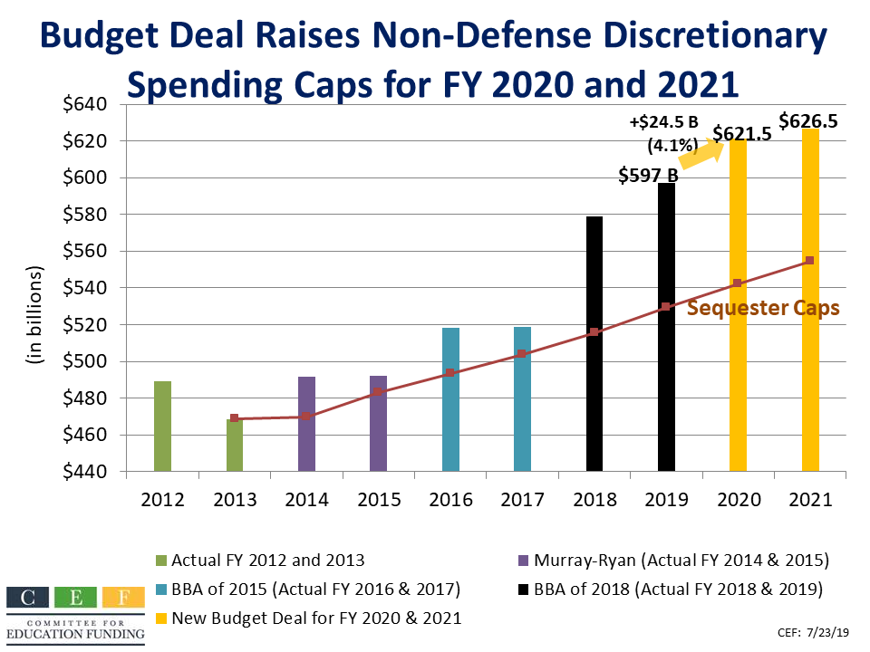
Budget Deal For BY20 & 21

Slide 13
Overview of the Caps Since FY12 Courtesy of the Committee for Education Funding
Discretionary Caps
 | 2012 | 2013 | 2014 | 2015 | 2016 | 2017 | 2018 | 2019 | 2020 | 2021
Original caps
Defense |  |  |  |  | 577 | 590 | 603 | 616 | 630 | 644
NDD | 489 | 489.9 | 506 | 520 | 530 | 541 | 553 | 566 | 578 | 590
Sequester
Defense |  |  |  |  | 523 | 536 | 549 | 562 | 576 | 590
NDD |  | 468.491 | 469.773 | 48313 | 493.491 | 503.531 | 515.666 | 529.202 | 543 | 555
Actual caps
Defense |  |  |  |  | 548 | 551 | 629 | 647 | 667 | 672
NDD | 489 | 468.491 | 492 | 492 | 518 | 519 | 579 | 597 | 622 | 627
Spending outside the caps
OCO for defense |  |  |  |  |  |  |  | 69 | 71.5 | 69
OCO for NDD |  |  |  |  |  |  |  | 8 | 8 | 8
Census |  |  |  |  |  |  |  |  | 2.5
Actual versus original caps:
Defense over original caps |  |  |  |  |  |  | 26 | 31 | 37 | 28
NDD over original caps |  |  |  |  |  |  | 26 | 31 | 44 | 37
Actual versus sequester caps:
Defense over sequester |  |  |  |  | 25 | 15 | 80 | 85 | 90 | 81
NDD over sequester |  |  |  |  | 25 | 15 | 63 | 68 | 79 | 72

Slide 14
Budget Control Act of 2011
Budget Control Act of 2011 drafted when the bipartisan, bicameral Supercommittee could not come to an agreement on what to do to wrangle in spending and address the debt and deficit.
Set non-defense and defense discretionary caps through FY21 along with a sequester of mandatory spending that now goes out to FY29
With this budget deal to raise the caps through FY21, sets up a new opportunity for Congress to work to address the debt and deficit, as well as other things.

Slide 15
Appropriations: U.S. Senate

Slide 16
Status of Appropriations Bills
Once budget deal is passed by the Senate and signed into law, the Senate will get to work on its appropriations bills (passage expected week of July 29, 2019)
Expecting the markup of the Labor-H & Defense bills the week of September 9, when Congress returns from August recess
Unclear if the Senate can move the package before the end of the Fiscal Year (September 30, 2019)
Critical is the allocation of the NDD increase: Labor-H contains approximately 33% of the NDD funds, but rarely receives its proportional share of the increase
Could expect some cuts in education programs…

Slide 17
What to Expect as We Head to September 30
Senate will move as many bills through sub & full committee as it can
Expect to see some minibuses
Current plan is to pair Labor-H and Defense again (Possible passage before end of fiscal year????)
Definitely a Continuing Resolution through sometime between October – December for bills not passed & signed into law by the end of the fiscal year– could be all of them as they will have to conference with the House

Slide 18
U.S. Department of Education

Slide 19
Negotiated Rulemaking
U.S. Department of Education announced the creation of a negotiated rulemaking committee on Title IV of the Higher Education Act in the fall of 2018.
Structure: 1 main committee, which has the vote, and 3 subcommittees
Main Committee: Accreditation and Innovation Committee
Subcommittees:
Distance Learning and Educational Innovation
Faith-Based Entities
TEACH Grants
Consensus reached – ok to move forward!

Slide 20
What’s Next?
Released through the Federal Register
Public Comment period on draft (expect it to be 60-90 days, could be less)
Review of Comments (who knows the timeline?)
Release of Final Rule (final regulations) before October 31 so regulation is enforceable on July 1, 2020

Slide 21
The First NPRM – Accreditation
Proposed rule released on June 12, 2019 with a 30 day comment period (closes July 12, 2019) & is 413 pages.
Streamlining the institutional accreditation process; proposing to give accreditors more flexibility in approving new kinds of academic programs and allow troubled colleges more time to meet accreditation standards.
Easing the process for accreditors to earn federal recognition — a requirement to serve as a gatekeeper for federal financial aid — as well as to allow new accreditors to gain that status.

Slide 22
Articles & Analysis
National Association of Student Financial Aid Administrators
Inside Higher Education
Council for Higher Education Accreditation

Slide 23
TEACH Grant NPRM ???
We are expecting the TEACH Grant NPRM to move with the Faith-Based NPRM
Probably not completed by October 31, 2019
(time is very tight at this point, with other regulations expected to be released)
Possibility that the Secretary uses ability to accelerate the process or move to early implementation

Slide 24
Federal Work Study Experimental Site
As described by the U.S. Department of Education’s Office of Federal Student Aid Experimental Sites Initiative:
This experiment aims to determine whether, by reducing the difficulty to institutions of paying FWS wages to students employed by private-sector companies, increasing the number of hours an FWS student is permitted to work, and removing restrictions on allocations to on-campus, off-campus, and community service jobs, institutions can cultivate additional private-sector opportunities for employment of FWS students. In addition, the experiment aims to determine whether off-campus, private-sector FWS jobs improve student completion rates, reduce student borrowing, reduce time to degree completion, or lead to improved employment outcomes.

Slide 25
Federal Work Study Experimental Site, continued
This experimental site also includes student teaching – meaning clinical practice opportunities!
Need to work with your institution’s financial aid office and the staff that implement federal work study at your institution.
Need to apply by SEPTEMBER 23, 2019
Resources
Federal Register Notice – includes how to apply
US DOEd Office of Federal Student Aid Experimental Sites
includes training and other information on this opportunity

Slide 26
Higher Education Act Reauthorization

Slide 27
U.S. House of Representatives
Democratic controlled, but with both a Republican and Democratic marker bill from 115th Congress.
The marker bills are VERY different; hard to imagine that coming to consensus will be easy; is it achievable?
Beginning with 6 or more bipartisan hearings.
Not sure how things will unfold

Slide 28
House Hearing on Title II of HEA & ESSA
Educating our Educators: How Federal Policy Can Better Support Teachers and School Leaders
July 17, 2019 Watch the hearing
Witnesses:
Dr. Michael Brosnan, Teacher and Early Leadership Institute Coach, Bridgeport Public Schools, Milford, CT
Ms. Tricia McManus Assistant Superintendent for Leadership, Professional Development and School Transformation Hillsborough County Public Schools Tampa, FL
Mr. John White State Superintendent of Education, State of Louisiana Baton Rouge , LA
Dr. Andrew Daire Dean, School of Education, Virginia Commonwealth University, Richmond , VA (AACTE MEMBER)

Slide 29
U.S. Senate
Chairman Alexander and Ranking Member Murray have a long history of bipartisan work.
History of hearings and hearing from the stakeholders.
Challenges unfolding:
Focus of reauthorization;
Areas of agreement;
Areas of differing views;
Negotiated Rulemaking in process on Title IV
Timeline, as laid out by Senator Alexander (it’s an election year!)
House cannot change much to ensure passage signing into law.

Slide 30
Negotiations Unfolding
Democratic staff starting with Senator Harkin’s bill from 2014: S. 2954
S. 2954 Title II High Level Overview
Changes to TQP
New state grant to implement deeper accountability for educator preparation “Educator Preparation Reform Grants”
Augments Title II data collection
Requires annual quantifiable goals for increasing the number of educators prepared in shortage fields
Funds to the states contingent on accountability of programs & outlines metrics to be used
Some part B programs retained

Slide 31
Perspectives on the Talks, Where is Title II?
Facing challenges we have heard before:
TQP is effective, but the scale is too small
States not holding teacher preparation accountable
Not enough data or data collection is an unfunded mandate
Question on who should engage in TQP – remove higher ed as a required partner
Higher education does not know the results of the graduates in the classroom including retention, effectiveness, and placement
Would connecting to Title II of ESSA funds eligibility provide a path forward?

Slide 32
Overall Challenges & Perspectives
Politics of the committee in the Senate – 2 members running for the Democratic nomination for President
Some tough places of difference between the Republicans and the Democrats throughout the bill that could bring about an end
Timeline tight – but keep in the mind the last time HEA was reauthorized it was signed into law in early August in a Presidential election year.
Chairman is retiring, is this his legacy?
Piecemeal vs full reauthorization
Can a Republican led Senate get a Democratic House to support?

Slide 33
REMEMBER: YOUR Voice Makes a Difference!

Slide 34
IMPORTANT BACKGROUND WORK FOR YOUR ADVOCACY
Please be sure to do the following as you engage in advocacy:
Check your faculty/staff handbook to be clear on the guidelines to advocating using your title and institutional address.
Connect with your institution’s government relations staff to coordinate and collaborate in your efforts. You don’t want to inadvertently cause problems with your institution’s efforts and agenda.
Remember, you can always advocate as a private citizen, not using your title, institutional address & email.

Slide 35
Your Actions and Engagement

Slide 36
July 2019 Key Advocacy Actions
Send Back to School Event Invitations to your elected officials (state & federal) to share the good work of your programs and celebrate kicking of the school year.
BE SURE TO WORK WITH YOUR INSTITUTION’S GOVERNMENT RELATIONS STAFF TO ORGANIZE!
Explore and Utilize the AACTE Advocacy Center and the resources offered on the state and federal pages.
Watch the webinar “Staying Engaged with Advocacy in the Summer”
Stay tuned for new Advocacy Guides!

Slide 37
Please Sign Up for the AACTE Action Alerts
Remember, this is not limited to AACTE members –
your campus and national colleagues, your PK-12 partners, your students, your family & friends can all participate!
Please sign up and help spread the word!
http://bit.ly/ActionAlertSignup

Slide 38
Resources For YOU
Advocacy Center
Advocacy Guides – NEW GUIDES COMING SOON!
AACTE Action Alerts
Blogs – Ed Prep Matters (State and Federal coverage)
Twitter Engagement: @AACTE, @Koolbeck, @WAccte, @janewestdc
Websites on state and federal policy
Monthly Federal update webinars
Government Relations & Advocacy Committee webinars
State Policy Blogs & webinars COMING SOON

Slide 39
Questions?

Slide 40
dkoolbeck@aacte.org 202.478.4506

