Slide 1
AACTE Affinity Group for Hawkins Grantees
March 14, 2024

Slide 2
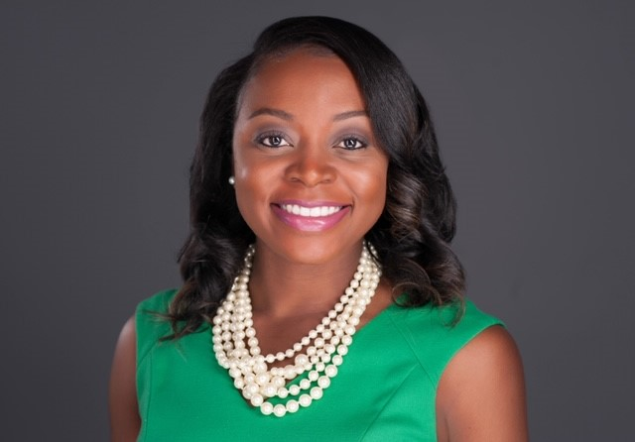
Weadé James, Ph.D.
Vice President, Organizational Advancement

Slide 3
Agenda
Introductions
Overview of Affinity Group
Needs Assessment and Goal Setting
Establish Norms and Next Steps

Slide 4
Introductions
Name
Institution and Role
Brief Overview of Project (Title, Focus Areas, Key Partnerships)

Slide 5
Overview
To provide a forum for shared learning and collaboration to promote the success of all Hawkins grantees. The Affinity Group will also engage in advocacy for increased funding for the Augustus F. Hawkins Centers for Excellence Program.

Slide 6
Small Group Activity: Needs Assessment
What do you hope to gain from being a part of a community with other Hawkins Grantees?
What needs does your project have that this community can help to inform and/or fulfill?
What sources of information or resources (e.g., data, other stakeholders) would be helpful to assist this group?

Slide 7
Establish Norms
Think about the best team/group experience you’ve had. What made the experience good?
What behaviors and team norms are needed to contribute to this group’s success?
How often should the group meet?

Slide 8
Next Steps
Next Meeting: Doodle Poll
Join Online Community (AACTE Connect 360 – Group Library, Discussion Board, Events)
Complete Goal Setting Survey
Register for AACTE’s Washington Week

